Slide 1
Lesion Detection in whole Histopathology Slides with Multi-scale Deep Learning
ISBI Camelyon16 Challenge
Prague, April 13, 2016
Oren Kraus, University of Toronto
oren.kraus@mail.utoronto.ca

Slide 2
Camelyon16 challenge
Detection of lymph node metastasis
First challenge using whole slide images
Deep learning has achieved state-of-the-art performance on segmentation and classification
Recently applied to mitosis detection in histology images (Cireşan et al., 2013)
Challenges for deep learning
Multiple scales
Large images to process

Slide 3
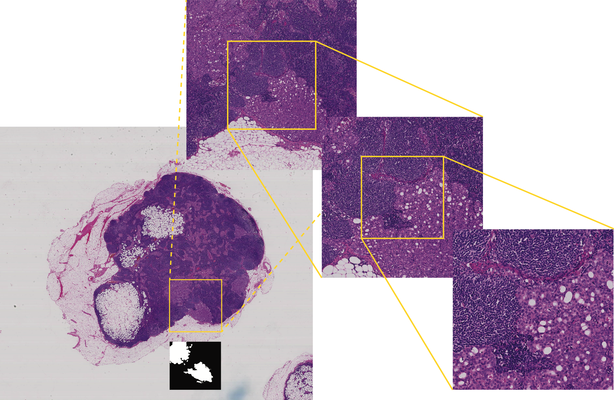
Challenge: Multi-scale, large images
Resolution: 3.6 μm
Size: 4096x3584
Resolution: 1.8 μm
Size: 7680x7168
Resolution: 0.9 μm
Size: 15,360x13,824
Resolution: 6.8 μm
Size: 2048x2048

Slide 4
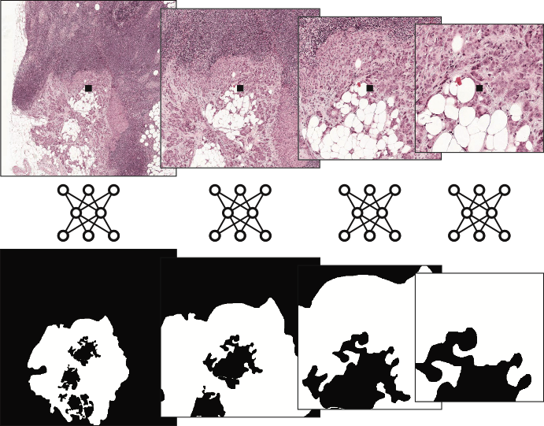
Convolutional Network Ensemble
aligned cropped samples across four scales
separate fully
convolutional
networks
ground
truth labels

Slide 5
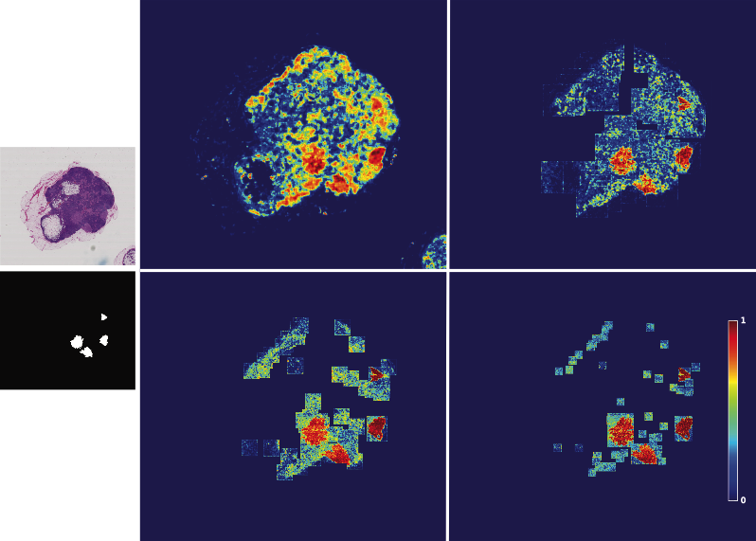
Evaluating Whole Slides
level 5
Level 4
ground truth
Level 3
Level 2

Slide 6
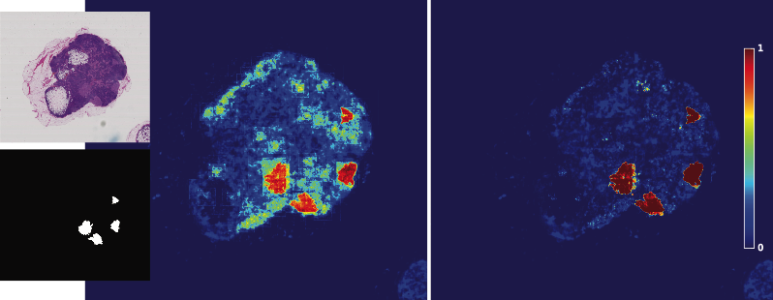
Aggregating Across Scales
additional fully
convolutional network
mean across scales
ground truth

Slide 7
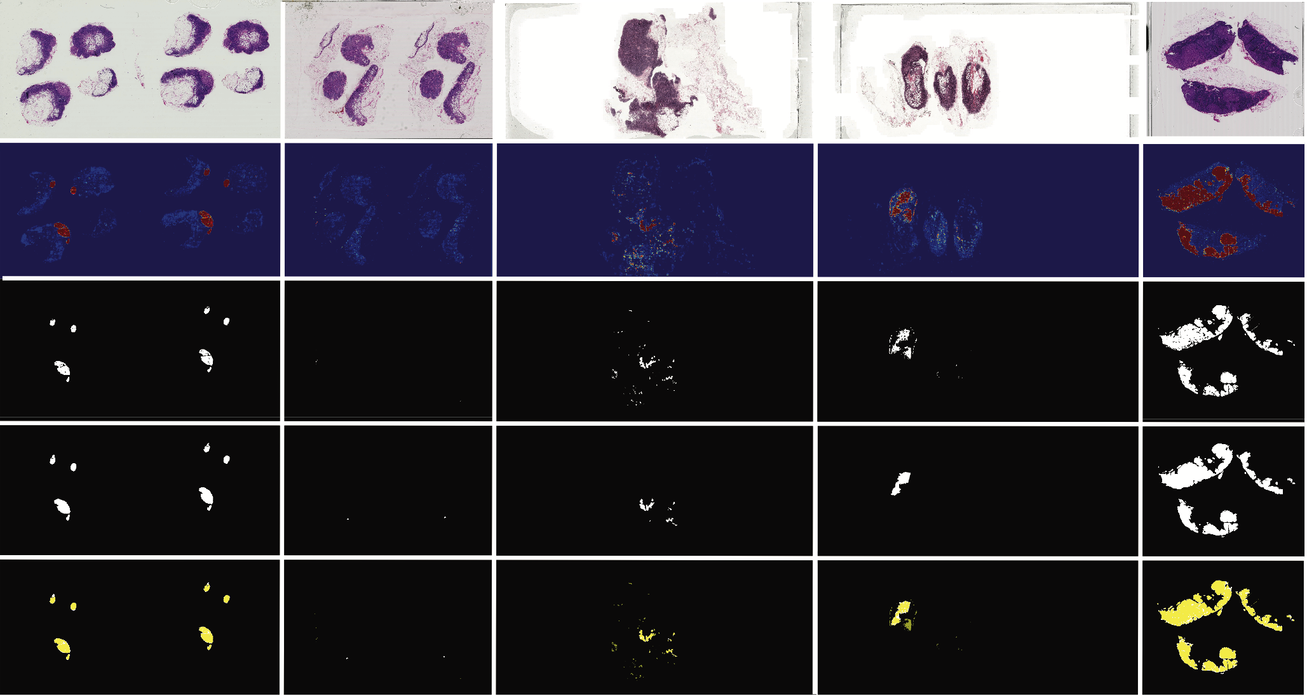
Segmentation Results
88
86
37
25
78
lesion prediction
segmentation
ground truth
overlay

Slide 8
Evaluation Results
Detection
 | detection sensitivity
aveFP | fully conv | mean
0.25 | 0.20 | 0.15
0.50 | 0.58 | 0.35
1.00 | 0.78 | 0.73
2.00 | 0.85 | 0.85
4.00 | 0.87 | 0.87
8.00 | 0.89 | 0.89
average | 0.70 | 0.64
Classification
 | AUC
fully conv | 0.93
mean | 0.85
Logistic regression based on measurements from detected lesions

